Slide 1
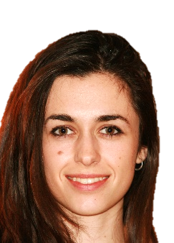

Guadalupe García Isla
Madrid, Spain
Guadalupe.garcia@polimi.it

Slide 2
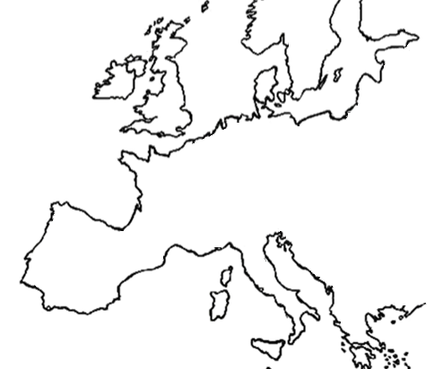





Universidad
Carlos III de Madrid
ESR9:
“Evaluation of the interplay mechanism between AF and AT detected by a single lead ECG”
Prof. Luca Mainardi
Prof. Valentina Corino
Bachelor’s Degree in
Biomedical
Engineering
PhD in
Biomedical
Master’s Degree in
Computational
Intensification:
Tissue Engineering and Regenerative medicine
Engineering
Biomedical
Engineering
Notes:
Add a more detailed description about what I have done. → Bachelor Thesis (Lab, cells, image analysis, piezoelectric materials…)
Master thesis (Project, publications, drive… )
My atria → objective and expectations → more clear objective about what I would be doing, what I have done and what are my netx steps to take-

Slide 3




Multidisciplinary International Network

Slide 4
THANK YOU!

