Slide 1


Assessment of the AF triggers and their role in its progression.
FRANCISCO JAVIER SAIZ VIVO
MIRKO DE MELIS
LUCA MAINARDI

Slide 2




A bit about me…
Bachelor: Industrial Engineering.
(Universitat Politecnica de Valencia)
Master: Industrial Engineering: Specialization in Electronics.
(Universitat Politecnica de Valencia)
Master: Biomedical Engineering: Technologies for Electronics.
(Politecnico di Milano)

Slide 3
A bit about my ESR…
To characterize the role of premature atrial activity (PAC) in the onset of AF in combination with other ECG parameters, like atrial fibrillatory rate.
To develop a PAC detector for a single lead continuous monitoring device, surface or subcutaneous.
To assess in specific clinical applications, i.e. ablation, if this approach can predict AF progression

Slide 4
Expected results
A comprehensive understanding of the PACs role as AF trigger and its combination with atrial fibrillatory rate to predict AF occurrence and to characterize its nature.
A comprehensive algorithm suitable for implementation in a single subcutaneous or surface, monitoring device; testing and validation will be done using the datasets coming from BRC clinical studies.
A clinical feasibility study, retrospective or prospective, where the patient status will be assessed using the aforementioned algorithm to predict AF progression.
4

Slide 5
Success of Ablation Strategies for PERS AF
Patients with persistent atrial fibrillation: no reduction in the rate of recurrent atrial fibrillation when either linear ablation or ablation of complex fractionated electrograms was performed in addition to pulmonary-vein isolation
Verma A, Jiang CY, Betts TR, Chen J, Deisenhofer I, Mantovan R, Macle L, Morillo CA, Haverkamp W, Weerasooriya R, Albenque JP. Approaches to catheter ablation for persistent atrial fibrillation. New England Journal of Medicine. 2015 May 7;372(19):1812-22.
5
Notes:
They know

Slide 6
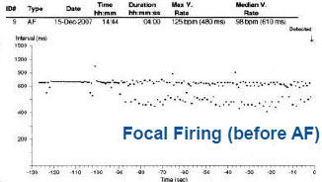
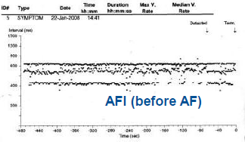
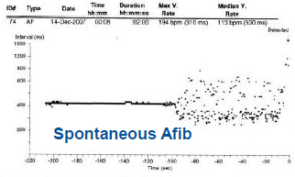
NEW Approach : EKG Markers Guided
Use LINQ triggers
The feasibility was positively
shown in a post-ablation studies
The new approach is to use them
pre-ablation
Pokushalov E, Romanov A, De Melis M, Artyomenko S, Baranova V, Losik D, Bairamova S, Karaskov A, Mittal S, Steinberg JS. Progression of atrial fibrillation after a failed initial ablation procedure in patients with paroxysmal atrial fibrillation. Circulation: Arrhythmia and Electrophysiology. 2013 Aug 1;6(4):754-60.

Slide 7
Research Questions
  Define triggers prevalence by patient category
  Assess if triggers are associated to procedure outcome at 1yr
  Are we able to define PAC patterns?
  Are able to detect PAC patterns?
  Is AF cycle length measured pre-ablation associated to procedure outcome ?
  -> physician validation of the data assessment
Notes:
[MIRKO]

Slide 8
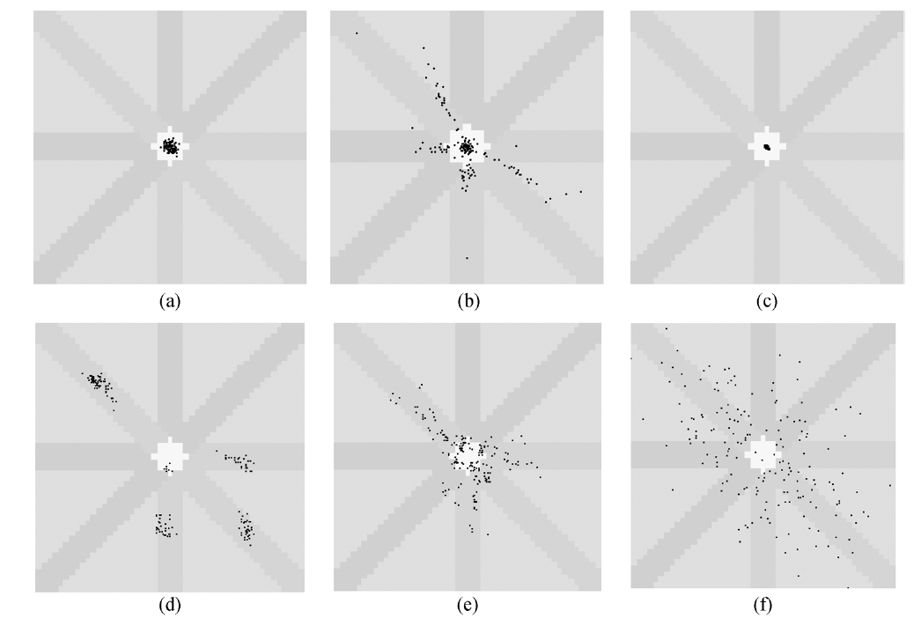
Lorenz plot
Shantanu Sarkar*, David Ritscher, and Rahul Mehra “A Detector for a Chronic Implantable Atrial Tachyarrhythmia Monitor”
Notes:
Al ready used for af detection, can be reused for pac patterns??

Slide 9
Assessment of the AF triggers and their role in its progression.
FRANCISCO JAVIER SAIZ VIVO
MIRKO DE MELIS
LUCA MAINARDI

