Slide 1
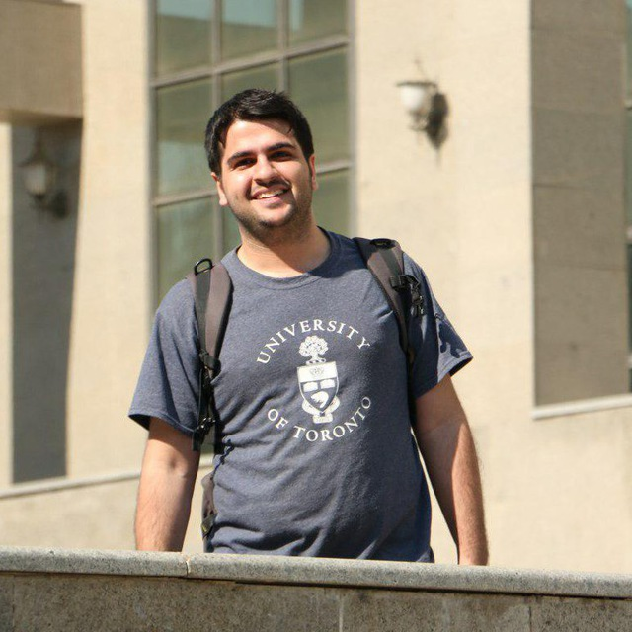

Mostafa Abdollahpur
B.Sc. Mechanical Engineering
M.Sc. Mechanical Engineering (control and dynamic systems)
At “K. N. Toosi University of Technology” in IRAN
Final thesis: Classification of heart sound recordings

Slide 2
ESR 7
Main supervisor : Frida Sandberg
Assistant supervisor : Pyotr Platonov
Goals :
Explorative analysis of ECG-signal characteristics during AF in response to changes in autonomic nervous system (ANS) activity.
Start development of tailored statistical models and methods for ECG-based quantitative analysis of cardiac ANS response in AF.

Slide 3
Secondments:
Experience from industrial R&D: Secondments at Medtronic (1-2 months) and Mortara (1-2 months)
Experience from the clinic :Skåne University hospital.
Experience from different academic institutes: UMIL (2-3 months)
Expectations of this Marie Curie experience:
Have experiences from industrial R&D to know the relation between real world and academic world
Have some good publications (for the academic area and sure for defense )

Slide 4
Thanks for your Attention

