Slide 1
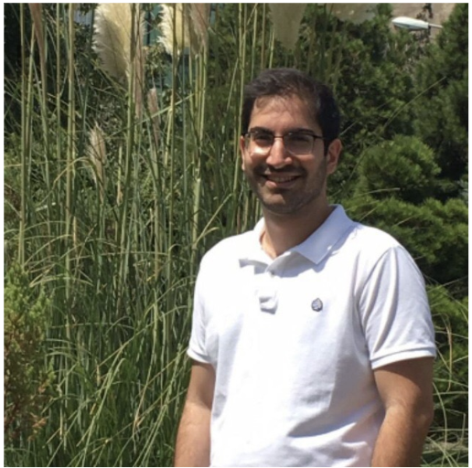
Name : Hesam Halvaei
Nationality : Iran
Background : BSc and MSc in Biomedical Engineering
Thesis : Detection of Effective Connectivity Alteration during Hypnosis Induction using Granger Causality Analysis
Notes:
Hi. I am hesam. I come from Iran. I got both my master and bachelor degree in Biomedical Engineering. In my master thesis I worked on Brain connectivity using EEG signals.

Slide 2
Project :ESR 6- Atrial fibrillation screening using everyday sensors and data fusion
Supervisors :Martin Stridh, Leif Sornmo at Lund University
Aims/Goals: to investigate and improve methodologies and strategies for Atrial Fibrillation (AF) detection and screening using :
Holters, thumb-ECGs, watches, patches, t-shirts, etc.
different types of signal modalities such as ECG, PPG, skin color, etc.
Expectation of MY-Atria Project: Gaining a rich network in academia and industry !
So Happy that I am here …!
Notes:
In my-atria project, I will be working ESR6: “AF screening using everyday sensors and data fusion At lund university. My supervisors are martin stridh and Leif Sornmo!
Within the my-Atria framework there will be a lot of networking opportunities both related to other PhD students and their respective research institution but also to participating hospitals and companies. In addition, there will be possibilities for networking at yearly conferences (e.g. Computers in Cardiology and Engineering in Medicine and Biology).

