Slide 1
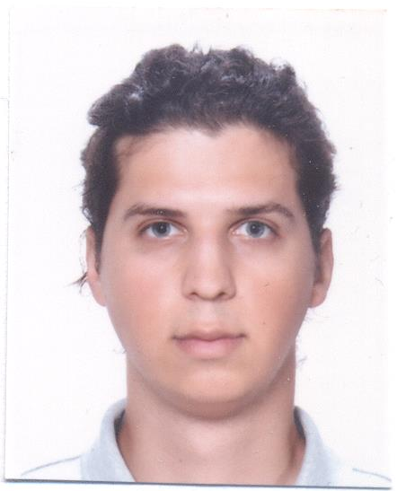
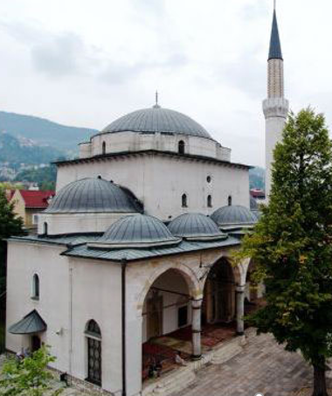
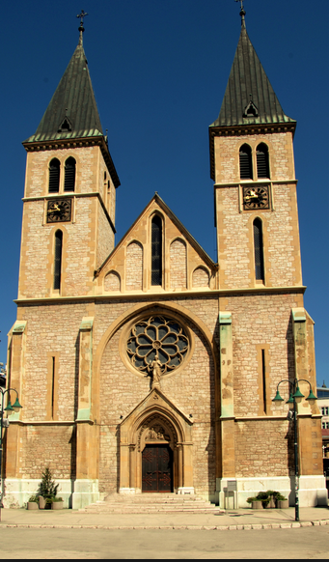
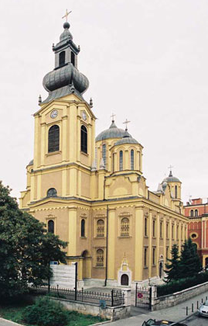
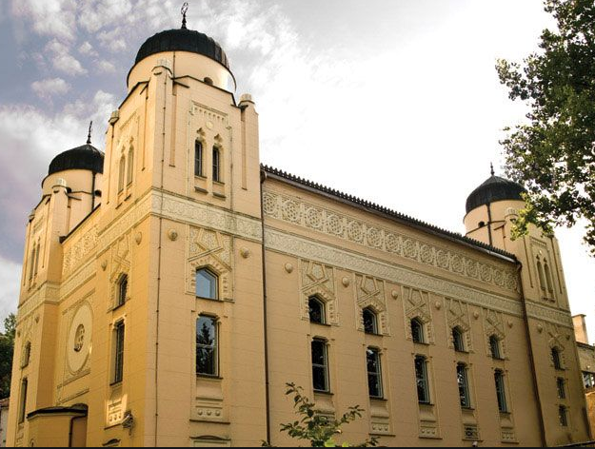
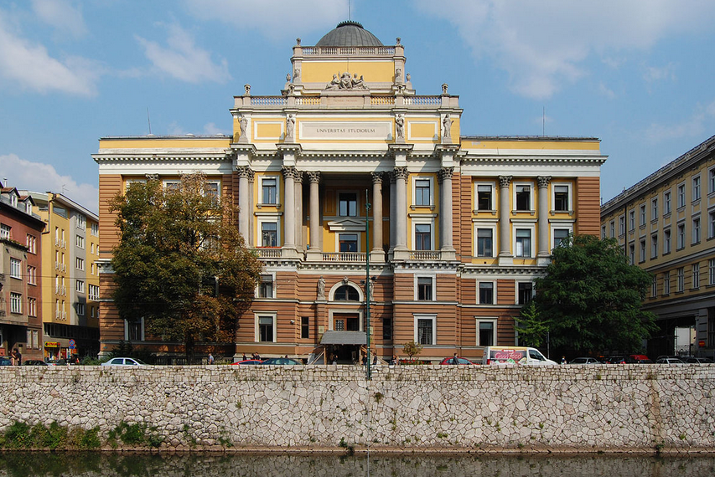
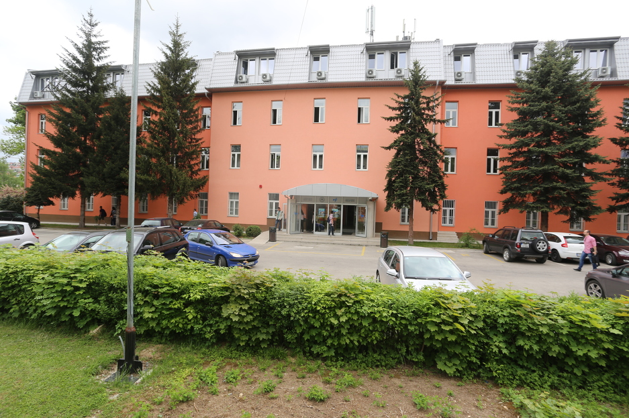
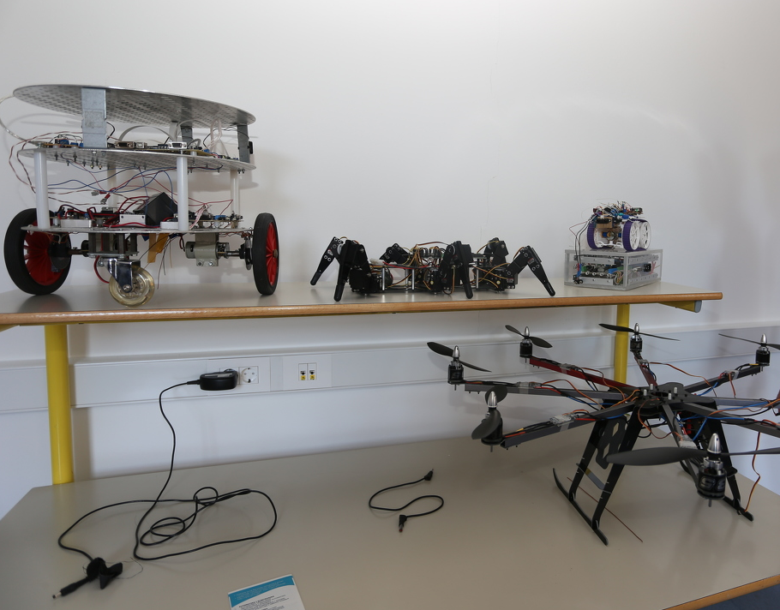
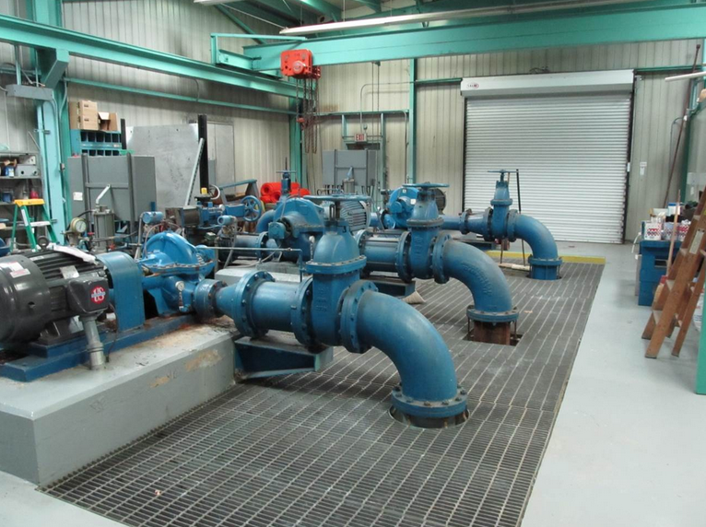
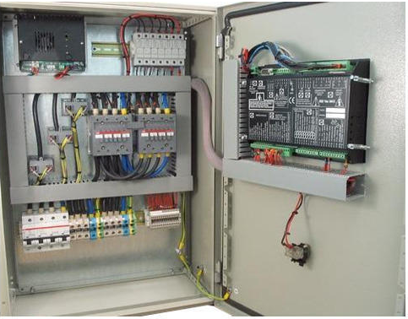
Muhamed Vila
born 23 September 1993
Sarajevo, Bosnia and Herzegovina
University of Sarajevo
Faculty of Electrical Engineering
Department for Automatic Control and Electronics
18 months work experience as Control Systems Engineer

Slide 2
Project title: Atrial complex networks in endocavitary recordings during AF
Objectives: To study concurrent EGMs collected in different positions within the atria in term of complex network measures
To quantify local circuitry and their stability
Expected results: A solid background in the theory of complex network and in the electrophysiological properties of the atria
Testing and selection of relevant metrics, using computer simulation of the electrical activity of the atria
A validation of the metrics with the design of proper experimental protocol to be conducted, after informed consent, during routine electrophysiological interventions

