Slide 1
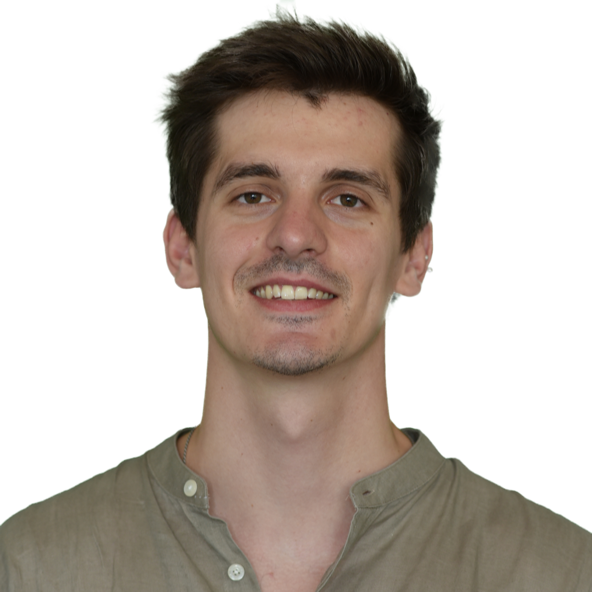
Body Surface Potential Maps and ECG-signals of AF
Early Stage Researcher (ESR) 3: Giorgio Luongo

Slide 2


About me
Bachelor in Clinical Engineering, Faculty of Civil and Industrial Engineering.
Master in Biomedical Engineering, Interfaculty between ‘Civil and Industrial Engineering’ and ‘Computer, Control and Management Engineering Antonio Ruberti’.
Internship at the Foundation Santa Lucia about Advanced Methods of Biosignal Analysis.
ESR 3 at Institute of Biomedical Engineering at the Karlsruhe Institute of Engineering (KIT), Karlsruhe, Germany.
Supervisor: Prof. Dr. Olaf Dössel
Co-supervisor: Dr.-Ing. Axel Loewe

Slide 3
Body Surface Potential Maps and ECG-signals of AF
Objectives:
To understand the relationship between various patterns of depolarization in the atria and the corresponding 12-lead ECG and BSPM.
To understand whether the atrial depolarization patterns can be detected and localised reliably based on BSPMs and in a 12-lead-ECG.
Expectations:
Competence in modeling and simulation in Biomedical Engineering
Competence in linking modeling results to clinical results.
New expertise in areas and techniques related to Electrophysiology and Atrial Arrhythmias.
International network of knowledge.
Work experience in a research lab, and assistance to a professor.
Secondments:
University of Zaragoza
University of Milan
Mortara Instrument
Karlsruhe hospital

Slide 4





Thank you!!

