Slide 1
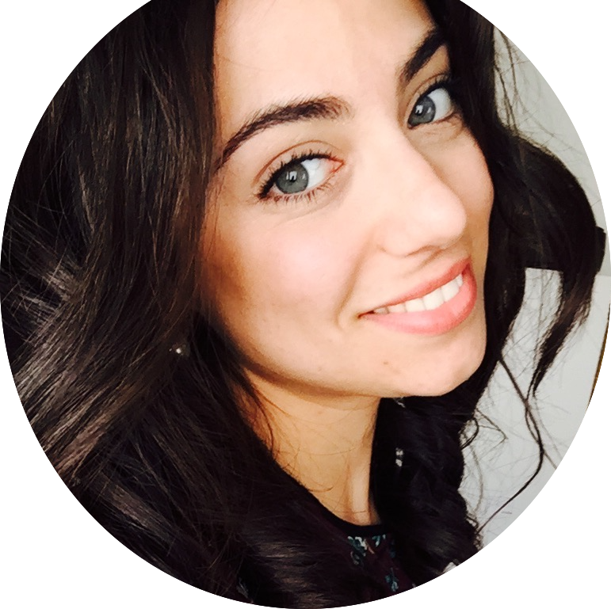
Rebecca Belletti
Biomedical Engineer
From Italy, Marche
Bachelor and Master Degree carried out at Politechnical University of Marche in Ancona
Master Degree mainly focused on signal, data and image processing and analysis
Organization
Team working
Flexibility
Programming and coding (Python, Matlab)

Slide 2
Detailed 3-D computer models of human atria and torso for studying atrial fibrillation initiation and progression
Supervisor: prof. JAVIER SAIZ
Co-Supervisor: prof. LUCIA ROMERO
Aims to develop:
Detailed 3-D models of both normal and dilated atrial morphologies with anatomical details and electrophysiological heterogeneities.
Electrophysiological models of the AF types (paroxysmal, persistent, permanent), with different fibrosis degrees
Models of ion channels mutations that can favour AF development and progression
Expectations:
Realistic computer models of atria with different anatomical, electrophysiological and structural characteristics.
A relationship between the different AF types and biomarkers obtained from simulated surface bioelectrical signals
Sensitivity analysis of different AF types and relation with ionic channel mutations.

