Slide 1
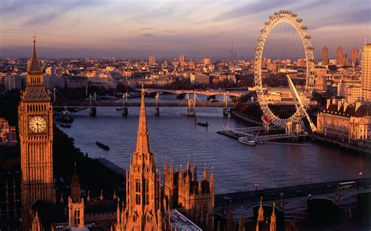
Who am I?
Name: Jordan Elliott
Education: Master of Biomedical Engineering
Awarding Body: University of Surrey

Slide 2
ESR1
Title: Bottom-up study on the implications of interatrial block in the mechanisms of atrial fibrillation
Supervisors: Luca Mainardi, Jose Felix Rodriguez-Matas
PhD granting Institution: Politecnico di Milano
Description of project
Using computational modelling, mapping the AP propagation through the heart and torso in response to various interatrial blocks
Investigating how this varies with different atrial anatomy and possibly different torso size
Using a Population of Models to study the effect of variation in conductivity of different atrial regions
Using atrial models provided by Olaf Dössel and Axel Loewe
Axel Loewe, Martin W. Krueger, Fredrik Holmqvist, Olaf Dössel, Gunnar Seemann, and Pyotr G. Platonov. (2016). Influence of the earliest right atrial activation site and its proximity to interatrial connections on P-wave morphology. Europace (2016) 18, iv35–iv43 doi:10.1093/europace/euw349.

Slide 3
Project expectations
In depth knowledge of the electrophysiology of the heart
Understanding of the significance of anatomic and electrophysiological variability
Determine the effects of variability and IABs on the P-wave of the ECG
Develop computational modelling skills
Experience a culture different to England
Learn Italian

Slide 4
Secondments (preliminary)
OMP (December 2018)
KIT (April 2019)
BRC (March 2021)

