Slide 1
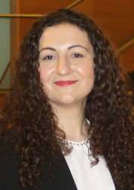

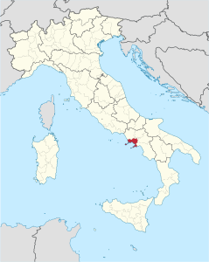


Jennifer Riccio
Naples, Italy
The past...
Bachelor’s degree in Biomedical Engineering (BME) at University of Naples “Federico II”, Italy
Thesis title : Clinical applications of Brain Computer
Interfaces
Supervisor : Professor Alessandro Pepino
Master’s degree in Biomedical Engineering at University of Naples “Federico II”, Italy
Thesis title : Liver segmentation from CT
images: comparison of automatic
and semi-automatic methods and
evaluation of their reproducibility
Supervisors : Professor Mario Sansone
Professor Andrés Santos (UPM)
Professor María J. Ledesma-Carbayo
(UPM)
Signals and images processing
Biomedical instrumentation
BME
Electrophysiology
Statistical data analysis
ENG
MED
Notes:
PARA TITULO:
SIMPLEX BANNER
SIMPLEX…
CUERPO
- ARIAL NARROW

Slide 2

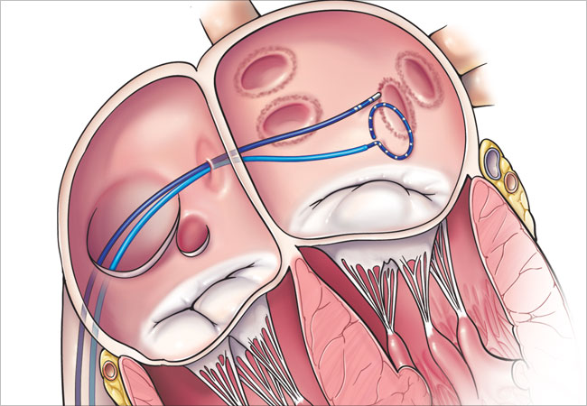

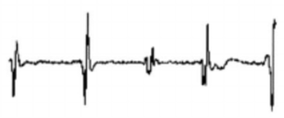

...the present...
ESR12 at University of Zaragoza, Spain
Project title : Characterization of Atrial Fibrillation (AF) dynamics for ablation guidance
and prediction of its efficacy
Supervisors : Professors Juan Pablo Martínez and Pablo Laguna
Ablation target
b-EGM
Methods development
Validation
Ablation guidance
Simulation
Ablation target strategy
Clinical data
Feedback
Characterization of AF dynamics
Clinical problem definition
Data collections

Slide 3



and the future
What do I expect?
Scientific contributions
New approaches to the cardiac signals processing
Papers, conferences, patents
Experience
Collaborations with other teams
Career
Relationships with research, clinical and industrial institutions
Post-doctoral position

