Slide 1
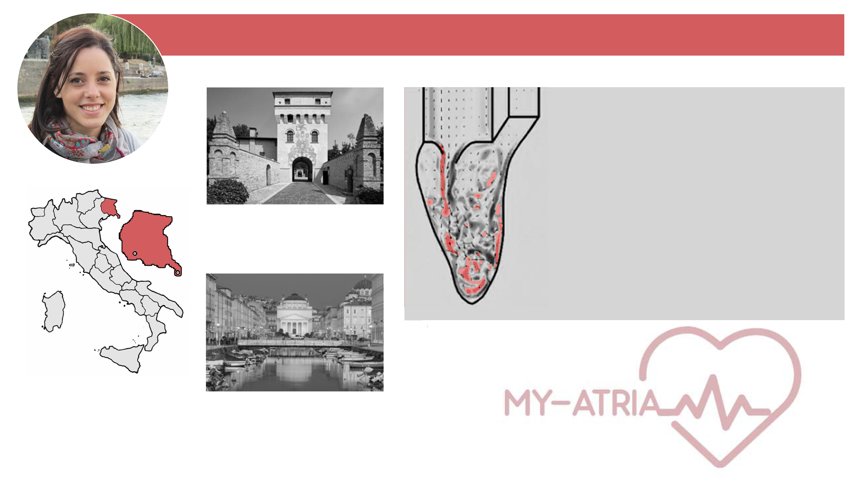



Chiara Celotto
Master in Environmental Engineering:
COMPUTATIONAL FLUID DYNAMICS
NUMERICAL MODELING (Finite elements, Finite differences)
Sesto al Reghena (PN), Italy
Thesis: ‘Flow-structure interaction in the mitral valve of heart’
Supervisor: Professor Gianni Pedrizzetti
Bachelor and Master’s studies:
Università degli Studi di Trieste
Trieste, Italy

Slide 2

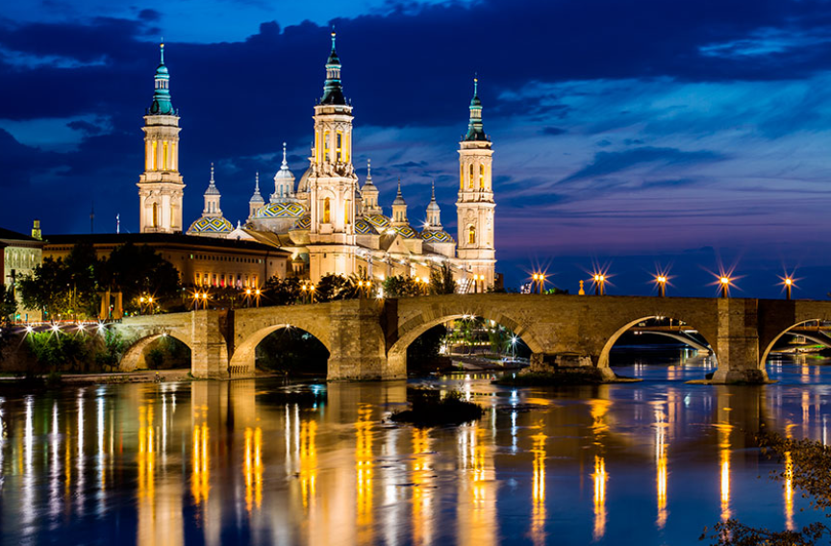

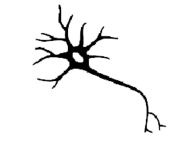
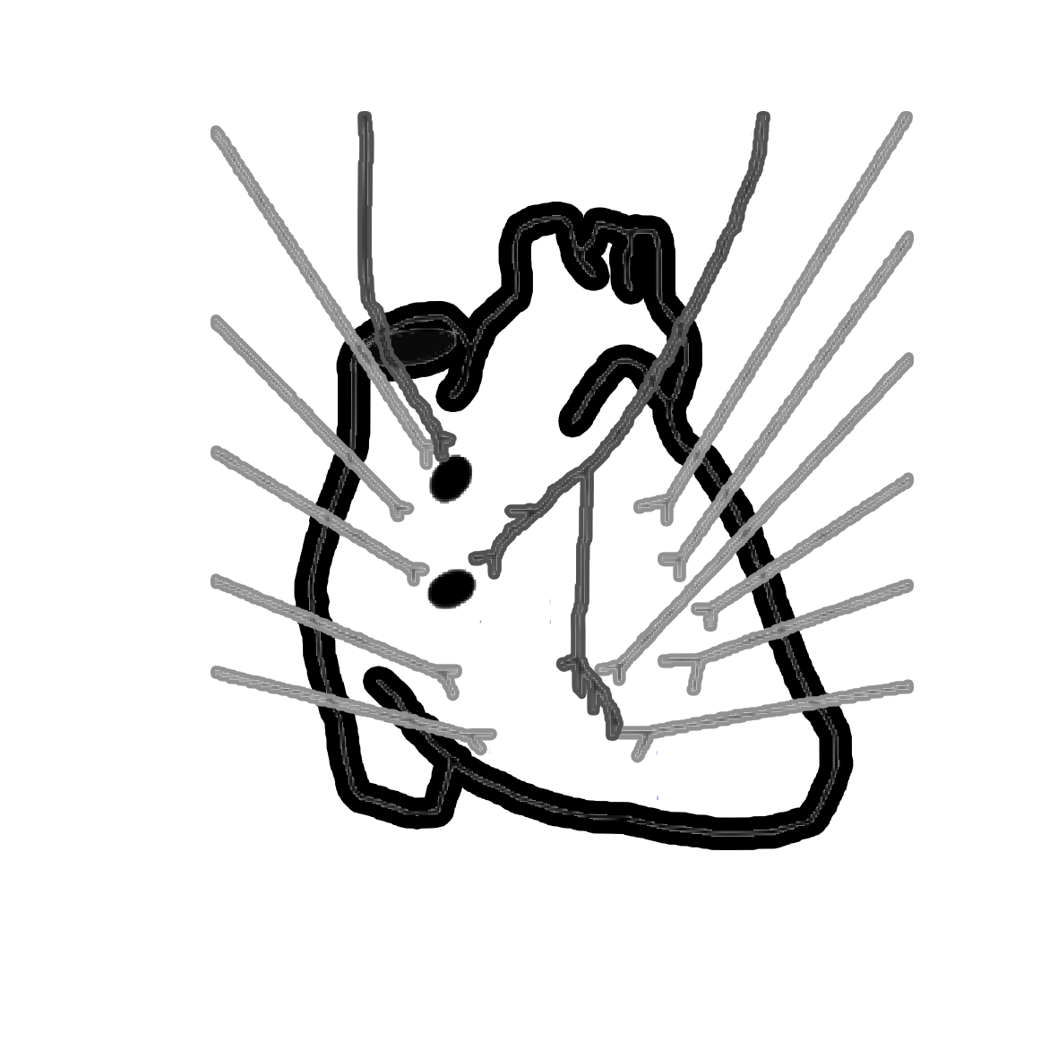
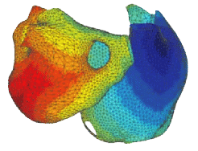

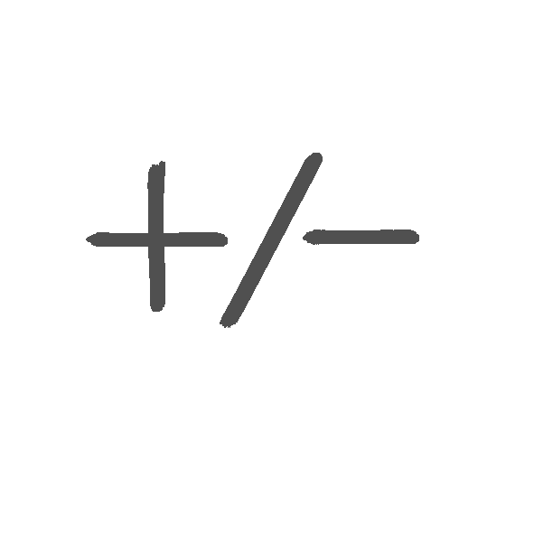


ESR11: ‘Assessment of AF therapies targeting ion channels and neural components’
Supervisor: Pablo Laguna,
Co-supervisor: Esther Pueyo
SYMPATHETIC / PARASYMPATHETIC
NERVOUS SYSTEM
AUTONOMIC
INTERVENTIONS
STOPPING AF
INITIATION / MANTEINANCE of AF
EXPERIMENTALLY-BASED HUMAN ATRIAL COMPUTATIONAL MODELS
ANTI-ARRHYTHMIC DRUGS
(SK CHANNELS)
AGING

Slide 3










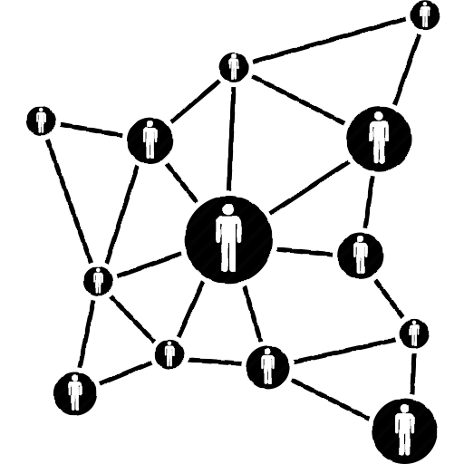





MULTI-SCALE MODELING AND SIMULATION
ORIGINAL CRITICAL THINKING
COMUNICATION
NETWORKING
POST-DOC / ITN
RESEARCH CAREER

