Slide 1

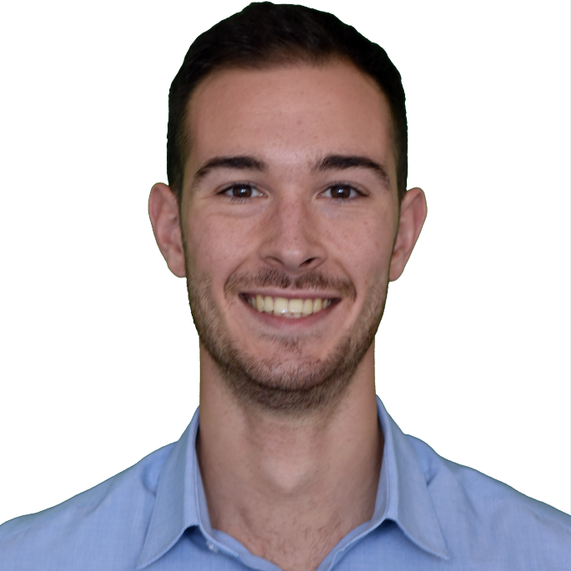
Integrated and personalized computational model of atria with AF for an efficient ablation therapy
MY-ATRIA Project – ESR 10
Luca Azzolin

Slide 2



Luca Azzolin
General informations:
Italian, born in Arzignano (VI) on the 21/05/1993.
Languages: Italian, English and Spanish.
Hobbies: sports (football, gym, running), reading books, hanging out with friends.
Education:
24/09/2015: Bachelor of Science Degree in Mathematical Engineering - Thesis: "FitzHugh-Nagumo model" - Advisor: S. Salsa - Politecnico di Milano
09/2016 - 01/2017: Erasmus - Universitat Politecnica de Catalunya, Barcelona
20/09/2017 - 24/11/2017: Student Visitor for Master Thesis - École Polytechnique Fédérale de Lausanne, Lausanne
19/04/2018: Master Degree in Computational Science and Engineering - Thesis: "Electromechanical modelling of the human heart in bi-ventricle geometries" - Advisors: A. Quarteroni, L. Dedè and A. Gerbi - Politecnico di Milano - Mark: 110/110 cum laude
Notes:
As a mathematical engineer, my decision to apply for a MY-ATRIA ESR position was perfectly aligned with my will to keep on finding new ways to tackle real-life problems with mathematical tools. Moreover, I am confident that my interestes in multi-scale and multi-physics modelling and numerical methods applied to biomathematical and engineering problems could help me to accomplish my final goal with passion and dedication.

Slide 3




Integrated and personalized computational model of atria with AF for an efficient ablation therapy
Supervisors:
Prof. Dr. rer. nat. Olaf Dössel (olaf.doessel@kit.edu)
Dr. Ing. Axel Loewe (axel.loewe@kit.edu)
Objectives:
To develop computational models of the atria of patients suffering from AF including lines of ablation
To compare in-silico arrhythmic depolarization patterns with the ones observed in in-vivo investigations and to develop a framework to adapt the model of the atria to fit to the measured signals
To implement a tool that enables the cardiologist to create ablation points and lines in the personalized atrial model. The vulnerability of the atria to AF will be estimated and the ablation pattern that is able to prevent the onset of AF will be determined.
Secondments:
Universitat Politecnica de Valencia (3m): To work on patient specific models of atria
Medtronic BRC (2m): To work on AF-monitoring
Karlsruhe Hospital (3m): To work on the acquisition of clinical data
Notes:
This project aims to take advantage of the immense potential offered by computational modelling applied to biomedicine. Computer simulation will be used to predict the response of the human heart to personalized treatments and a tool will be implemented for the clinics, providing higher probability of success in preventing arrhytmic activities. From this experience I expect to gain a unique intersectoral competence, having the possibility to spend some time in universities, in a biomedical company and in an hospital, obtaining a PhD title with both academical and professional skills. It is a great opportunity for me to work together with maximum experts in various fields, professors, doctors and engineers gathered together with a final aim, a technological development for atrial disease monitoring and treatment.

Slide 4

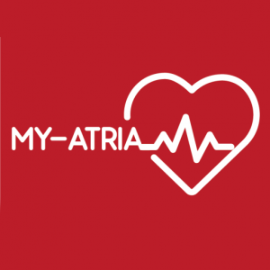

Thank you all!

